Slide 1
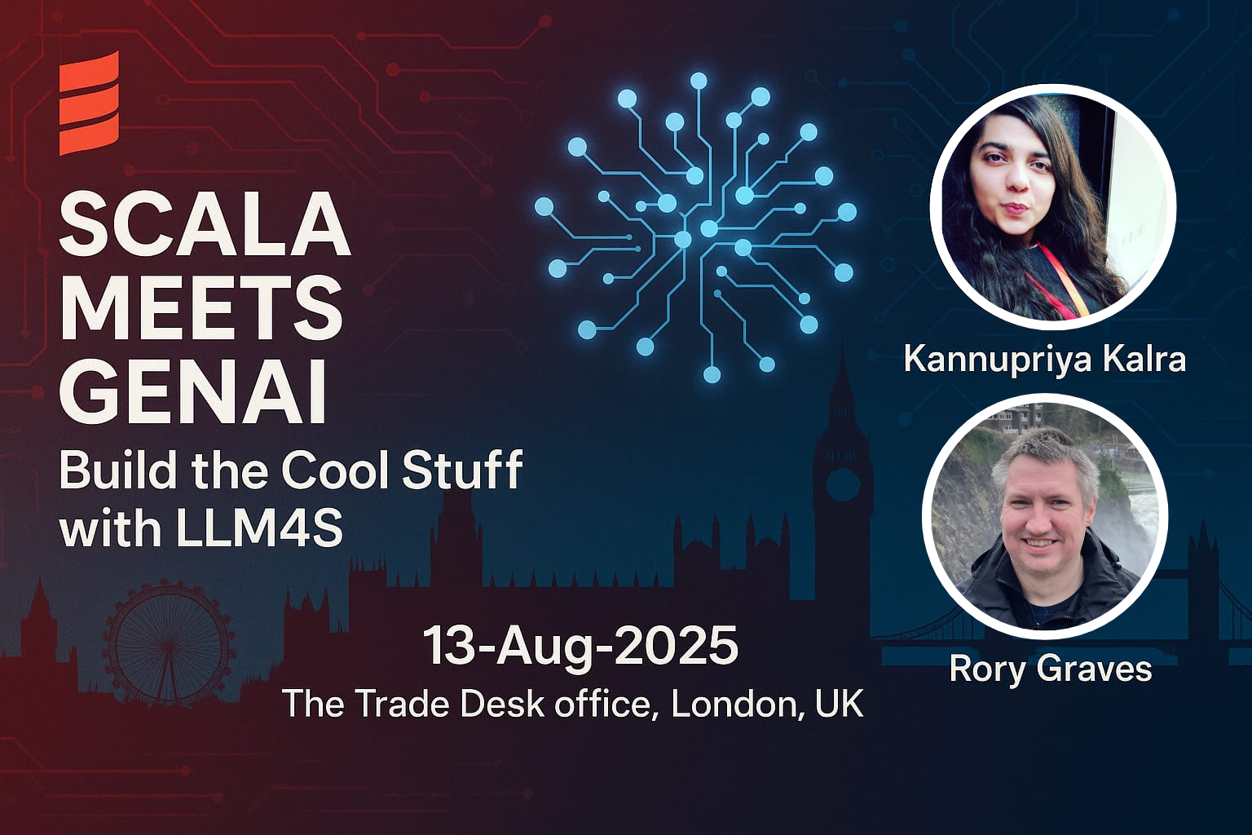

Slide 2
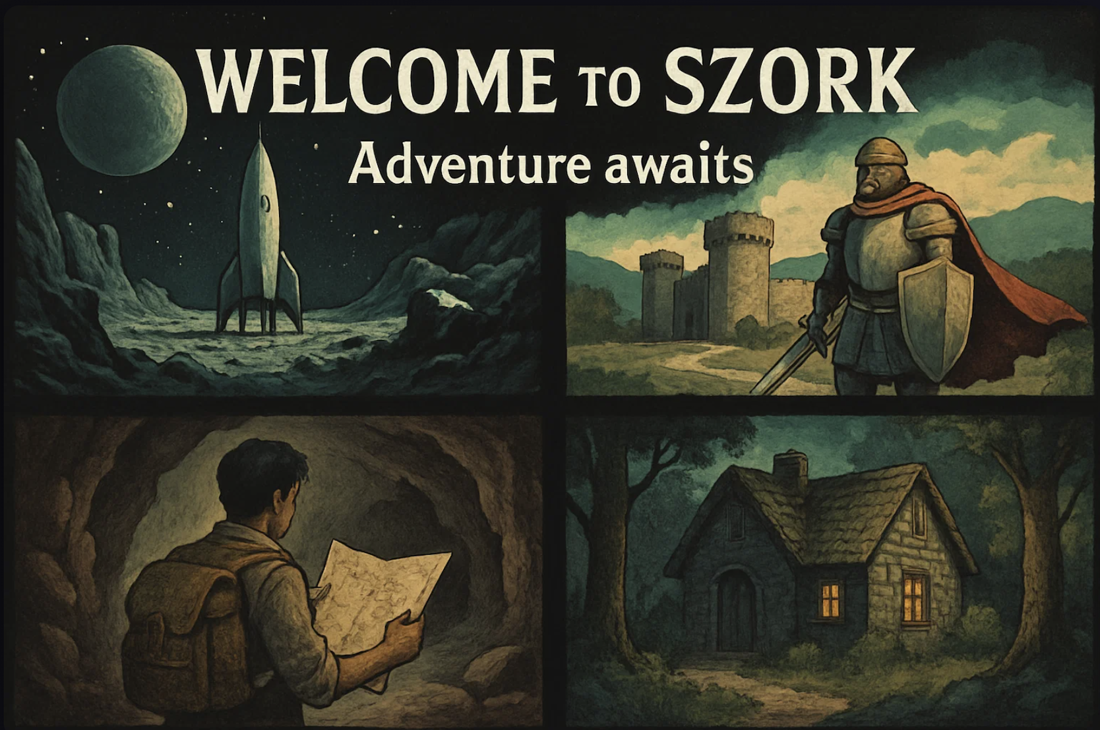

Let's Play SZork!
100% Scala-Powered AI Adventure
Notes:
This is SZork - a fully AI-powered text adventure game. Everything you're about to see - the story, the images, the music - is generated in real-time by AI, orchestrated entirely through Scala and LLM4S.

Slide 3
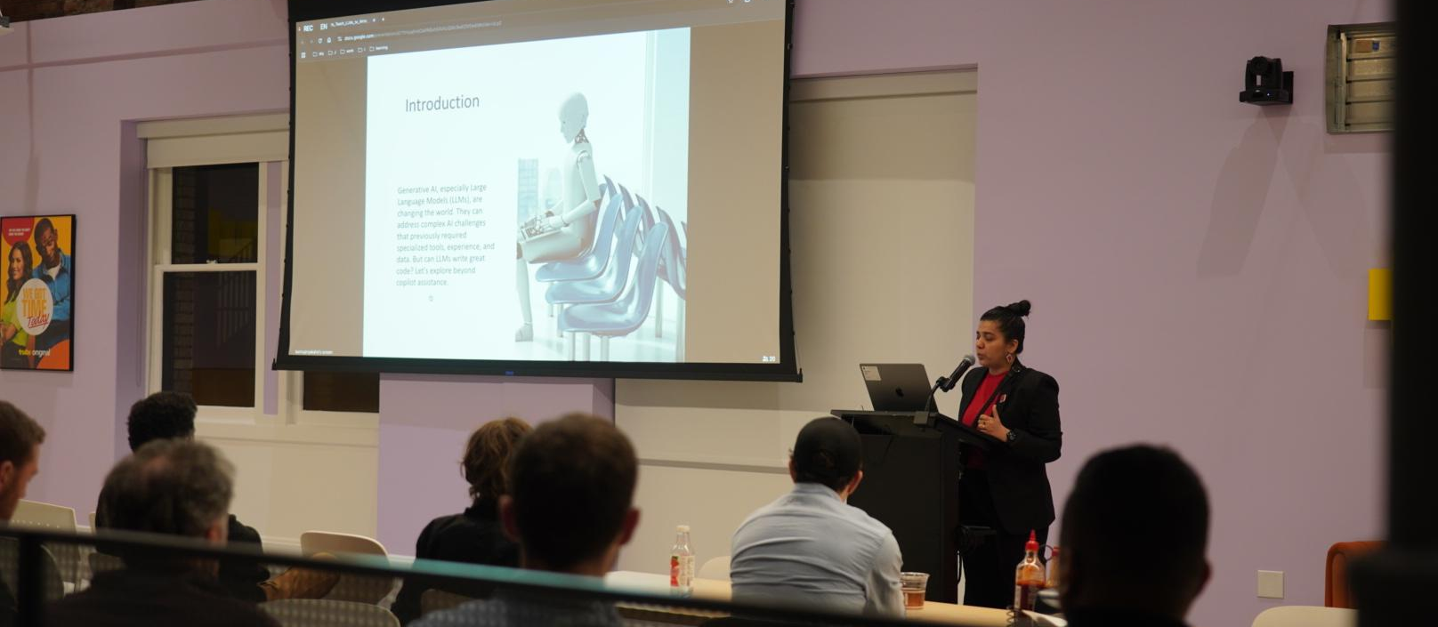
The Magic Behind the Scenes
Notes:
[Open browser dev tools] Look at this - every aspect is powered by different AI services, all orchestrated through LLM4S. No Python, no JavaScript AI libraries - pure Scala managing this complex multi-modal experience.

Slide 5
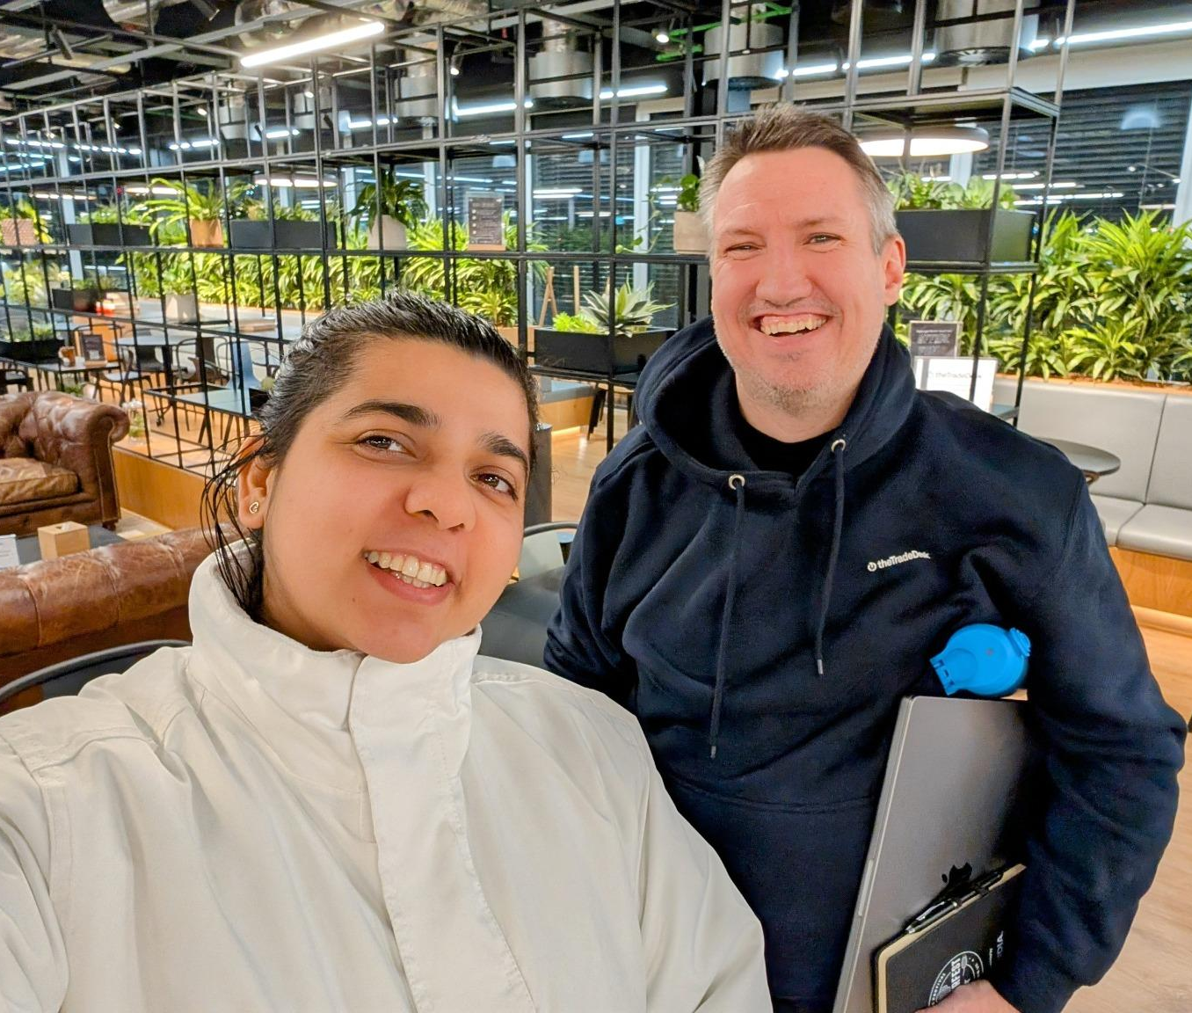
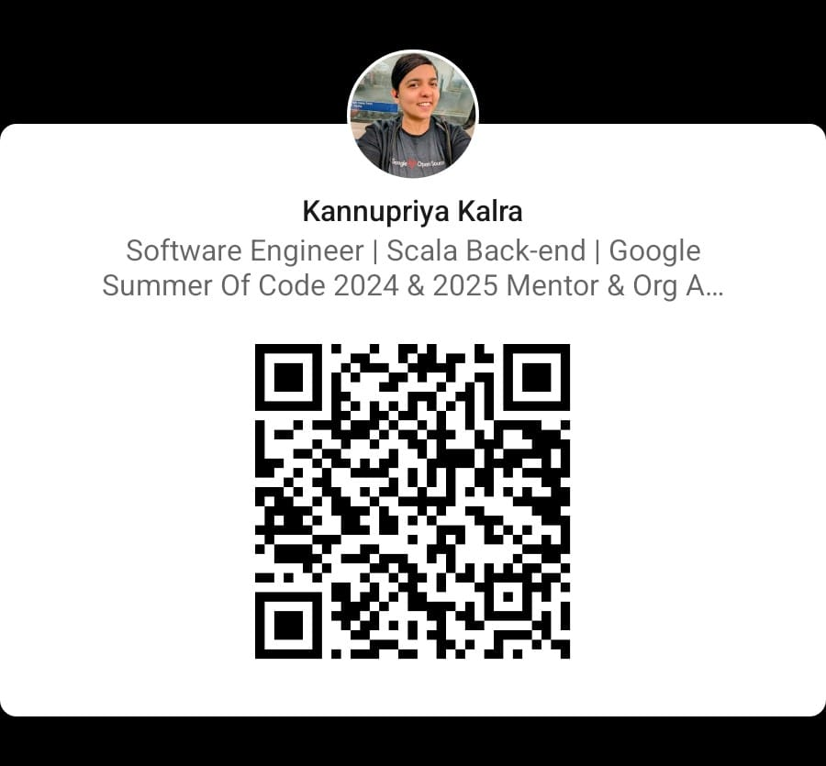
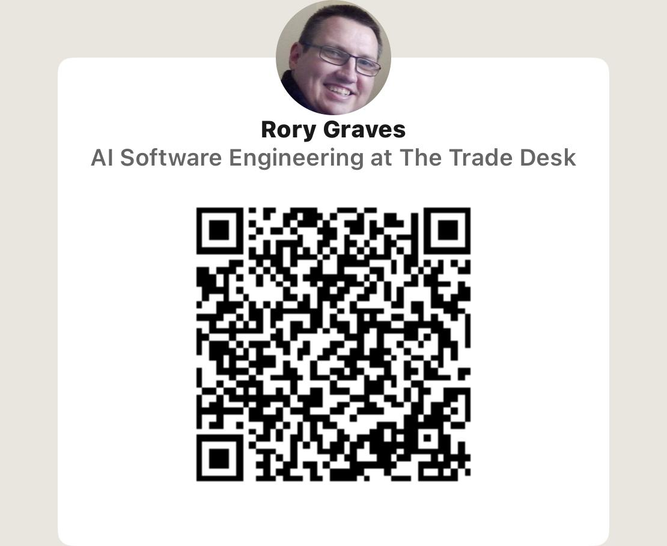
Who We Are
Rory Graves
A Scala advocate and software engineer with 30+ years of experience across diverse systems. He has contributed to Scala compiler optimizations and supports AI/ML research while mentoring developers. Beyond tech, he is a martial artist, windmill tour guide, and public speaking mentor. LinkedIn: https://www.linkedin.com/in/roryjgraves/
Kannupriya Kalra
A Scala developer with 10 years of experience in backend engineering, big data, and functional programming. A Google Summer of Code mentor & Scala Center admin, she has contributed to Scala CLI and Scaladex and has spoken at global conferences. LinkedIn: https://www.linkedin.com/in/kannupriyakalra/
Notes:
Before we wrap up, I’d like to take a moment to introduce the incredible maintainers of LLM4S. Rory Graves, a Scala expert with over 30 years of experience, has made significant contributions to Scala compiler optimizations and AI-driven research. A huge thank you to Rory for being an amazing co-maintainer on this project, for his invaluable contributions to the creation of LLM4S, and for the opportunity to work alongside him in maintaining it.
We’d be delighted to connect on LinkedIn to discuss this project further. Looking forward to collaborating with you!
If you’re interested in exploring LLM4S or discussing topics related to open source, Scala, and AI, we’d love to have you join us at the upcoming London Open Source Hack Night tomorrow at 10 AM PST, both online and in person for those in London. You can find all the details in my LinkedIn post for this talk!
This image is from the Scala Open Source Hack Night in London, where we brainstormed and discussed the project.

Slide 6



Who We Are
Kannupriya Kalra
Original project creator
Background details here
Rory Graves
Original project creator
Background details here
Jan 2025
Feb 2025
March 2025
2025 Q2
Project inception at London Open Source Hacknight
First release and public announcement in Bay Area Scala Conference
Got funding from Google Summer of Code for 4 interns
Introduced it in various countries, worked on it with various OSS devs from India, Poland, USA, etc
Notes:
We're both original founders of LLM4S. We built it because there was a gap, and Python wasn't cutting it for enterprise scale. Then something amazing happened with Google Summer of Code...

Slide 7







LLM4S – Bringing AI to Scala
WHAT IS LLM4S?
HOW IT ENHANCES STRUCTURED, TYPE-SAFE AI DEVELOPMENT
CURRENT STATUS & ROADMAP
ROBUST TOOL CALLING
MULTI-STEP WORKFLOWS
AGENTIC PROGRAMMING
Notes:
Introducing **LLM4S**, a new Scala-first AI development toolkit. This project aims to bring structured, type-safe AI development to Scala. Here’s what LLM4S will offer:
- **Structured AI Workflows:** Ensuring AI-driven applications follow predictable, maintainable patterns.
- **Tool Calling & API Interactions:** Seamless integration with external tools, APIs, and databases.
- **Multi-step Workflows:** Supporting iterative development and feedback loops similar to Python's LangChain.
- **Agentic workflow framework**
- **Scala-Native AI Development:** Leveraging Scala’s strengths to improve reliability in AI workflows. - both in tooling and in code generation
Active development - GSOC
LLM4S is still evolving, but it promises to make AI development in Scala more accessible and efficient in multiple ways

Slide 8
The LLM4S Story
Notes:
We started LLM4S to solve our own problems. Google Summer of Code transformed it - students added embedding support, MCP integration, and more. This isn't just our project anymore - it's a community effort.

Slide 9
Beyond Games - RAG Architecture
Coming Soon: RAG
Notes:
Games are fun, but let's talk enterprise. RAG - Retrieval Augmented Generation - lets you query your own documents. Watch as we search through the LLM4S documentation itself...

Slide 10

Code Generation Power
Page Layout: Code editor view with side panel
Visual Specification:
Main area: Syntax-highlighted Scala code
Side panel: Generation parameters
Bottom: Type safety indicators
Green checkmarks for compilation
Code Generation Example:
???
Notes:
Watch this - we'll have AI generate a complete Scala tool. Notice the type safety - the AI respects Scala's type system. This isn't just code completion; it's understanding and generating idiomatic Scala.

Slide 11
Image Understanding
Use Cases:
• UI Element Detection → Automated Testing
• Text Extraction → PDF Processing
• Scene Description → Content Moderation
• Structure Analysis → Documentation
Notes:
It's not just about generating images - we can understand them too. Upload any screenshot and watch the AI describe it perfectly. This enables automated UI testing, accessibility tools, document processing...

Slide 12

Agent Architecture
Conversation
Message history
Immutable Seq[Message]
State Management
Agent state
Case classes
case class AgentState(
conversation: Conversation,
tools: ToolRegistry,
status: AgentStatus
)
Tool Registry
Available tools
Type-safe registry
Execution Loop
Orchestration
Tail-recursive
Notes:
Let's peek under the hood at how SZork's game agent works. Every conversation is immutable - we never mutate state. Tools are type-safe and composable. This is functional programming at its finest.

Slide 13
Tool Calling in Action
Page Layout: Flow diagram with code examples
Visual Specification:
• Step-by-step flow visualization
• Code snippets at each step
• Success/error paths clearly marked
• Type signatures highlighted
Tool Calling Flow:
Step | Action | Code
1 | Define tool | ToolFunction[Input, Output]
2 | Register | ToolRegistry(Seq(tool))
3 | LLM decides | complete(conversation, options)
4 | Execute | toolRegistry.execute(request)
5 | Return result | ToolMessage(id, result)
Notes:
Agents can call any tool you define. Here's a weather tool - the agent decides when to use it, executes it safely, and incorporates results. Next version of SZork will have inventory management tools!

Slide 14
Document Processing
Accuracy: 95%+
Notes:
Same agent pattern, different tools. Load a PDF, chunk it intelligently, search it semantically, summarize it. Build your own ChatPDF in Scala - with type safety and performance.

Slide 15
The Power of Scala

Slide 16

Python Code Example:
try:
result = client.complete(conversation)
except Error as e:
handle_error(e)
Scala Code Example:
val result: Either[Error, Response] = client.complete(conversation)

Slide 17

Python - Fails at runtime
result = client.complete(conversation)
Notes:
Why Scala for AI? Type safety catches errors at compile time. Immutability prevents state bugs. True concurrency for parallel API calls. This matters at scale - when you're processing thousands of requests.

Slide 18
What You Can Build
Conversational Agents
RAG Systems
Code Generation
Core
Enterprise
Developer
✓ Demo'd
✓ Coming soon
✓ ???
Image Processing
PDF Summarization
Semantic Search
Multimodal
Documents
Search
✓ Demo'd
✓ Demo'd
✓ Coming soon
AI Agents with Tools
Multi-step Workflows
Content Generation
Advanced
Automation
Creative
✓ Demo'd
✓ Demo'd
✓ Demo'd
Notes:
Everything on this slide - we've demonstrated it today. This isn't theoretical. You can build all of this with LLM4S, right now, in production, with Scala's safety and performance.

Slide 19
Production Features
Enterprise-grade features: Provider switching, Langfuse integration, MCP support, Type-safe error handling, Automatic retries, Smart caching
Notes:
This isn't a toy - it's battle-tested in production. Switch providers with one line. Full observability with Langfuse. MCP support for standardized tools. Graceful degradation when services fail.

Slide 20
Community & Ecosystem
GSoC Contributions:
Embedding support
MCP integration
Vector storage
Performance optimizations
Notes:
Google Summer of Code transformed LLM4S. Students added embedding support, MCP integration - major features that make it enterprise-ready. Join our Discord - the community is incredibly active and helpful.

Slide 21


Getting Started
1
Add to build.sbt
libraryDependencies += "com.github.llm4s" %% "llm4s" % "0.3.0"
2
Set API key
export OPENAI_API_KEY="sk-..."
3
Write code
import org.llm4s._
val client = LLM.client()
val response = client.complete(
Conversation(Seq(
UserMessage("Hello, Scala!")
))
4
Run
sbt run
Resources:
• GitHub: github.com/llm4s/llm4s • Docs: [URL] • Discord: [Invite link]
Notes:
Getting started is this simple. Add one dependency, set your API key, write a few lines of Scala. Everything you saw today - SZork included - is open source. Star the repo if you like what you see!

Slide 22



Join the Movement : Build the Cool Stuff
Action | Link | QR Code
Star on GitHub | github.com/llm4s/llm4s
Join Discord | [https://discord.com/invite/YF2cWQD4cg]
Try SZork | [https://github.com/llm4s/szork]
Coming Soon:
• Streaming support
• More providers
• Enhanced tool calling
• Production templates
Contact Information for Presenters
Notes:
You can build the cool stuff! Everything is open source. We're looking for contributors. Join our Discord. Star the repo. And remember - if you can write Scala, you can build amazing AI applications. Questions?

Slide 23
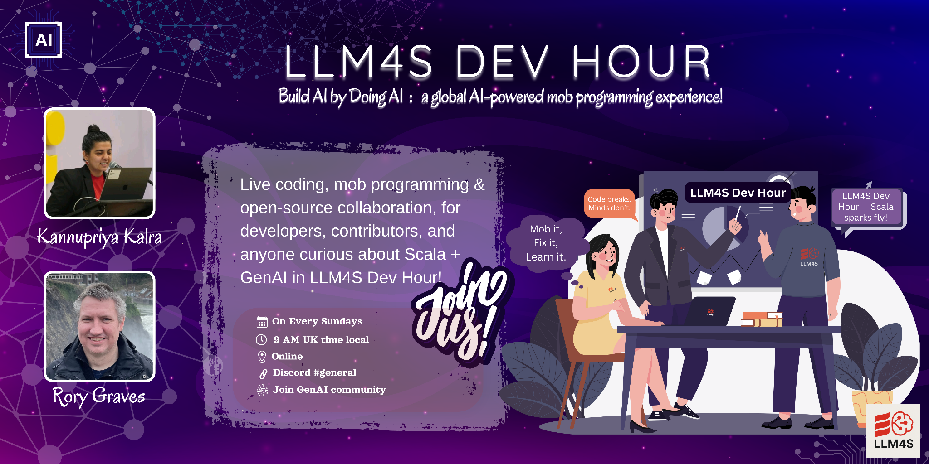

Slide 24
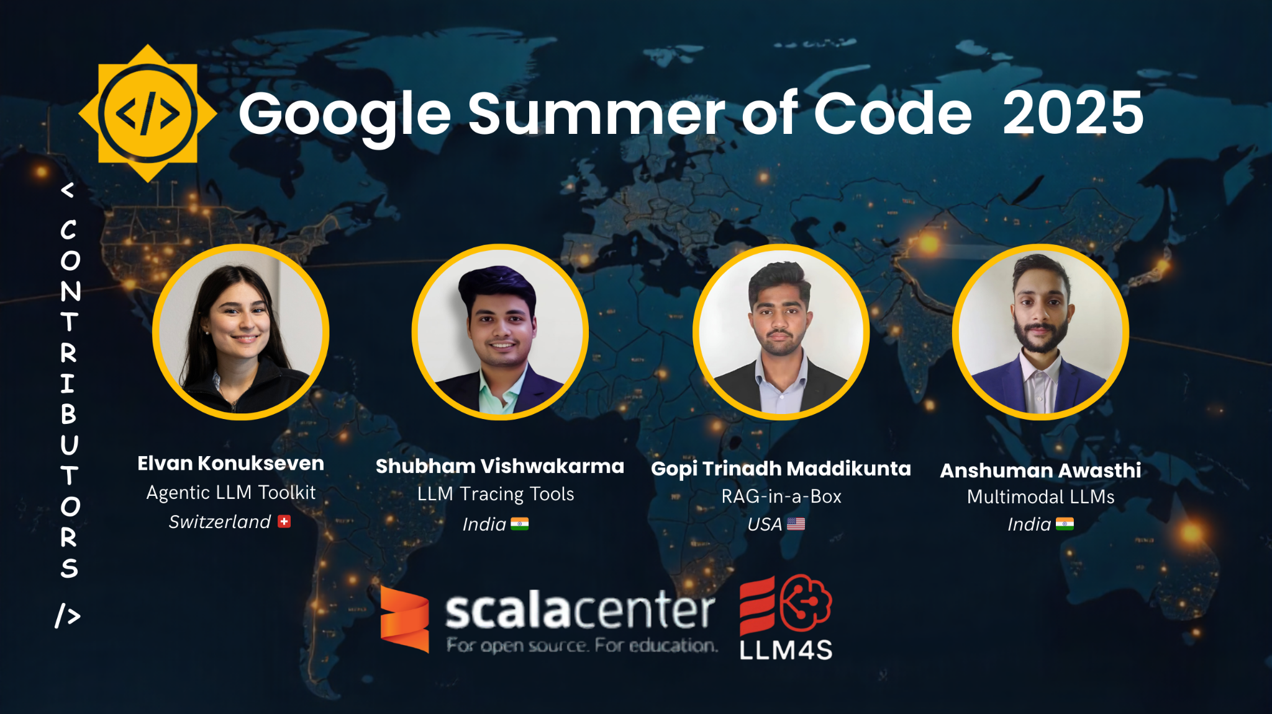

Slide 25

LLM4S GitHub Issues(https://lnkd.in/eXrhwgWY) 🌍 Join our growing GenAI community: https://lnkd.in/eb4ZFdtG
Explore the LLM4S project that bridges AI and Scala, fostering innovation in intelligent development
Notes:
As we close, I encourage you to explore how Scala can enhance AI development. Think about what a type-safe AI ecosystem looks like and how we can push the boundaries of AI in functional programming.
Interested in contributing? Check out LLM4S on GitHub, explore open issues, and join us in building a type-safe, AI-powered Scala ecosystem. We greatly welcome collaboration from AI engineers, Scala developers, and open-source enthusiasts alike! If you enjoyed the talk, please consider starring the project on GitHub.

Slide 26
Questions?
Kannupriya Kalra
Rory Graves
📧 kannupriyakalra@gmail.com
🐦 @kannupriyakalra_46520
💼 linkedin.com/in/kannupriyakalra
📧 rory.graves@fieldmark.co.uk
🐦 @rorybot1
💼 linkedin.com/in/roryjgraves
Notes:
We have a few minutes for questions. We'll also be around after the talk - come find us if you want to dive deeper into anything we've shown today.

